Slide 1
IBM University Engagement Project Submission
“Exploring the Power of Agentic AI with IBM Granite and LangFlow”

Slide 2

Project Tile – [ResearchPilot AI]
Domain of Project – [ Education ]
Student Name | Recent Passport Photo | Email ID | Mobile number [WhatsApp]
Kanak Saxena |  | Kanaksaxena1527@gmail.com | 9125084690
Recommended font style and size: Font Style: Arial Font Size (Heading): 28
Font Size (Content): 20

Slide 3
Problem Statement -
Problem Statement: ResearchPilot AI
The Challenge
Researchers and students spend significant time searching for relevant research papers, understanding complex content, and identifying research gaps. Academic information is spread across multiple sources, making literature review time-consuming and inefficient.
The Objective
Build an AI-powered Research Assistant that provides intelligent literature discovery and research support. The solution should:
Smart Literature Search – Find relevant research papers using natural language queries.
Research RAG Retrieval – Retrieve, summarize, and explain research papers with reliable citations.
Paper Analysis & Comparison – Compare multiple papers and highlight key insights, methodologies, and differences.
Research Idea Generation – Identify research gaps and suggest future research directions.
Multi-Agent System
Literature Search Agent (retrieves relevant papers)
Research Analysis Agent (summarizes and explains papers)
Paper Comparison Agent (compares research papers)
Research Assistant Agent (answers research questions and supports academic writing)
Research Dashboard – Organize papers, track progress, and visualize research insights.

Slide 4
Proposed Solution -
Proposed Solution: ResearchPilot AI
The proposed solution is a multi-agent AI-powered Research Assistant built using LangFlow, IBM watsonx.ai, and Granite Models to simplify academic research through intelligent literature discovery, analysis, and personalized research support. The system addresses the challenges of finding relevant papers, understanding complex research, and identifying research gaps using a modular AI architecture.
At its core, the solution uses a Retrieval-Augmented Generation (RAG) pipeline to retrieve research papers and academic documents from trusted sources. The documents are embedded and stored in a vector database, enabling the system to provide accurate summaries, contextual answers, and citation-aware responses using IBM Granite models.
Literature Search Agent retrieves relevant research papers based on natural language queries.
Research Analysis Agent summarizes papers, extracts key findings, methodologies, and conclusions.
Paper Comparison Agent compares multiple papers to identify similarities, differences, strengths, and research trends.
Research Assistant Agent answers research questions, identifies research gaps, and suggests future research directions.
The solution includes an intuitive dashboard (built with React or Streamlit) where users can search papers, manage their research library, compare studies, and track their research progress.
LangFlow orchestrates the multi-agent workflow, while IBM watsonx.ai provides scalable model deployment, embeddings, and AI governance. Granite models power reasoning, summarization, comparison, and intelligent research assistance.
Overall, ResearchPilot AI delivers an end-to-end AI research assistant that accelerates literature review, enhances research productivity, and helps users make informed, evidence-based decisions.

Slide 5
Technology Used
LangFlow – Multi-agent workflow orchestration.
IBM Granite Model (ibm-granite-3-2-8b) – Research paper summarization, reasoning, and question answering.
IBM watsonx.ai – Model deployment, embeddings, and AI governance.
Retrieval-Augmented Generation (RAG) – Context-aware retrieval of research papers.
FAISS Vector Database – Semantic search and document retrieval.
FastAPI – Backend API development.
React + Vite – Frontend development.
SQLite – Database for user data and research history.
IBM Cloud – Application deployment and scalable cloud infrastructure.

Slide 6
Langflow component Used -
Chat Input – Accepts user research queries, topics, or uploaded paper requests.
IBM watsonx AI Agent – Processes research queries using IBM Granite models for summarization, analysis, comparison, and question answering.
IBM Granite Model – Granite-4.0-8B-Instruct → Fast and efficient for research paper summarization, reasoning, and academic assistance.
Chat Output – Displays AI-generated summaries, comparisons, citations, and research insights.
File Component – Uploads and stores research papers (PDFs) for analysis and RAG-based retrieval.
FAISS Vector Store (Retriever) – Stores document embeddings and retrieves the most relevant research content for the RAG pipeline.

Slide 7

Role of Agentic AI in the solution
Role of Agentic AI in ResearchPilot AI
Agentic AI enables ResearchPilot AI to function as an intelligent, autonomous research assistant rather than a simple chatbot. Powered by IBM watsonx.ai and IBM Granite models, it coordinates multiple specialized AI agents to automate different stages of the research process.
Each agent performs a specific task, such as searching scholarly literature, summarizing research papers, answering questions from uploaded documents, comparing multiple papers, generating research ideas, and organizing references. These agents work together to provide accurate, efficient, and reliable research support.
Agentic AI also brings context awareness by understanding the user's research topic, uploaded papers, and previous interactions to generate personalized and relevant responses. It continuously adapts its recommendations as new documents and queries are added, ensuring up-to-date assistance throughout the research journey.
Overall, Agentic AI makes ResearchPilot AI proactive, collaborative, and goal-driven, helping students and researchers save time, gain deeper insights, and improve the quality and productivity of their research.

Slide 8
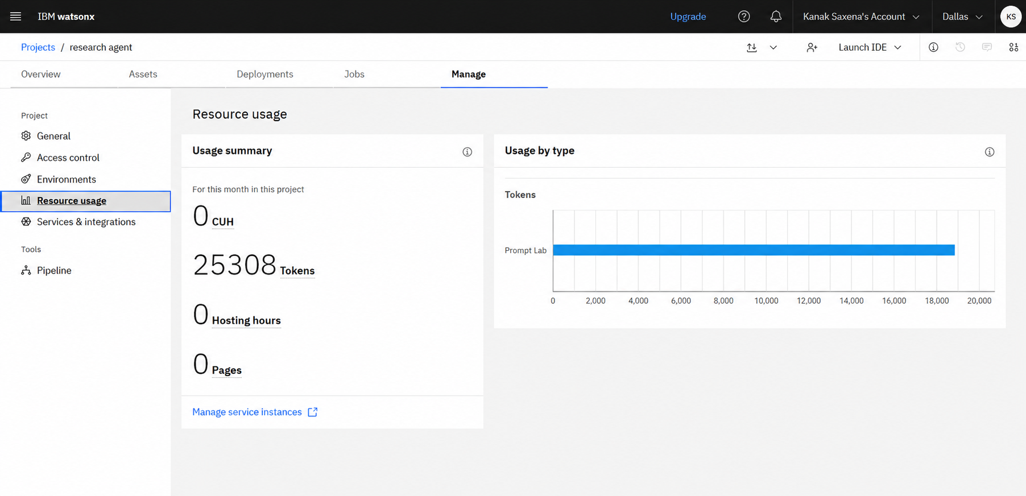
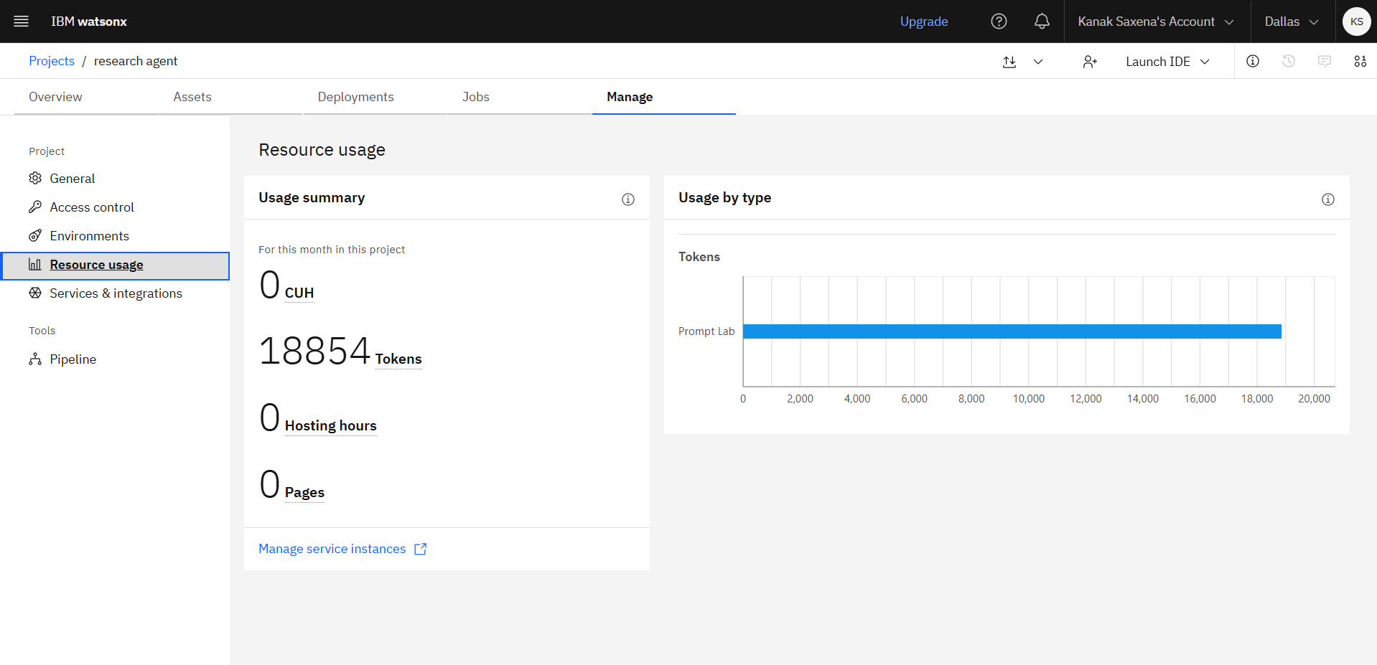
Token Usage
11,761 token are used
Before Prompt
After the Prompt
·
·
·

Slide 9
Novelty and Uniqueness
The proposed ResearchPilot AI introduces several innovative features that distinguish it from traditional research assistants and paper summarization tools.
Agentic Multi-Agent Architecture – Uses multiple autonomous AI agents that collaborate to perform different research tasks instead of relying on a single AI model.
Research Workflow Automation – Automates the complete research lifecycle, including literature search, paper analysis, comparison, summarization, idea generation, and citation support within one platform.
Context-Aware RAG Framework – Combines Retrieval-Augmented Generation (RAG) with conversation memory to provide accurate, context-aware, and personalized research assistance while minimizing hallucinations.
Gap & Novelty Detection – Analyzes multiple research papers to identify unexplored areas, research gaps, and potential future directions, helping researchers discover novel opportunities.
Cross-Paper Intelligent Reasoning – Goes beyond summarization by connecting information across multiple papers to generate deeper insights and meaningful comparisons.
Human-Like Research Assistance – Maintains context across the research session, understands user goals, and adapts recommendations as new papers and queries are added.
Secure & Scalable AI Platform – Built on IBM watsonx.ai with IBM Granite models, ensuring reliable, secure, and enterprise-ready AI capabilities.

Slide 10
Git Hub Link
https://github.com/Kanaksaxena15/ResearchPilot.git
·
·
·

Slide 11
Future Scope
1. Real-Time Research Monitoring
ResearchPilot AI can continuously monitor trusted research databases and notify users whenever new papers, journals, or breakthroughs related to their research topic are published. This will help researchers stay updated without manually searching for new literature.
2. AI-Based Research Proposal & Report Generation
Future versions can assist researchers in drafting research proposals, literature reviews, methodology sections, and technical reports. By using uploaded papers and user requirements, the AI can generate well-structured academic content, reducing writing effort.
3. Collaborative Research Workspace
The platform can be expanded to support team-based research by allowing multiple users to share papers, annotations, AI-generated summaries, and project progress in a common workspace. This will improve collaboration among students, researchers, and faculty members.
4. Integration with Academic Databases
ResearchPilot AI can be integrated with academic platforms such as arXiv, PubMed, IEEE Xplore, Springer, and other digital libraries. This will provide access to a larger collection of high-quality research papers and improve the accuracy and completeness of literature searches.
·
·
·

Slide 12
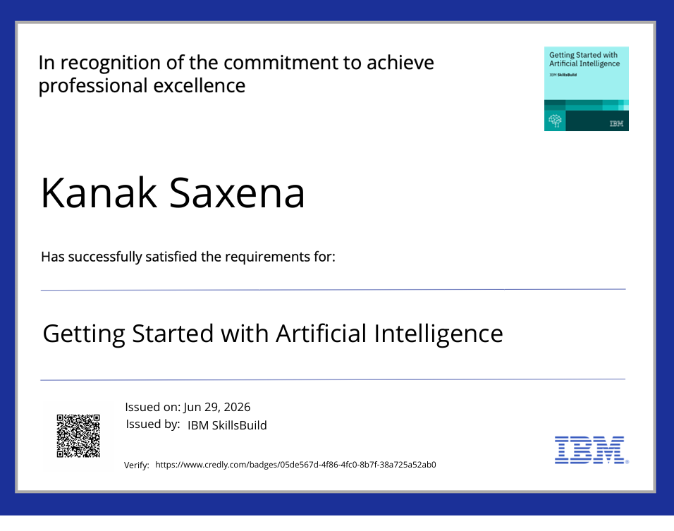
Certificates Earned:

Slide 13
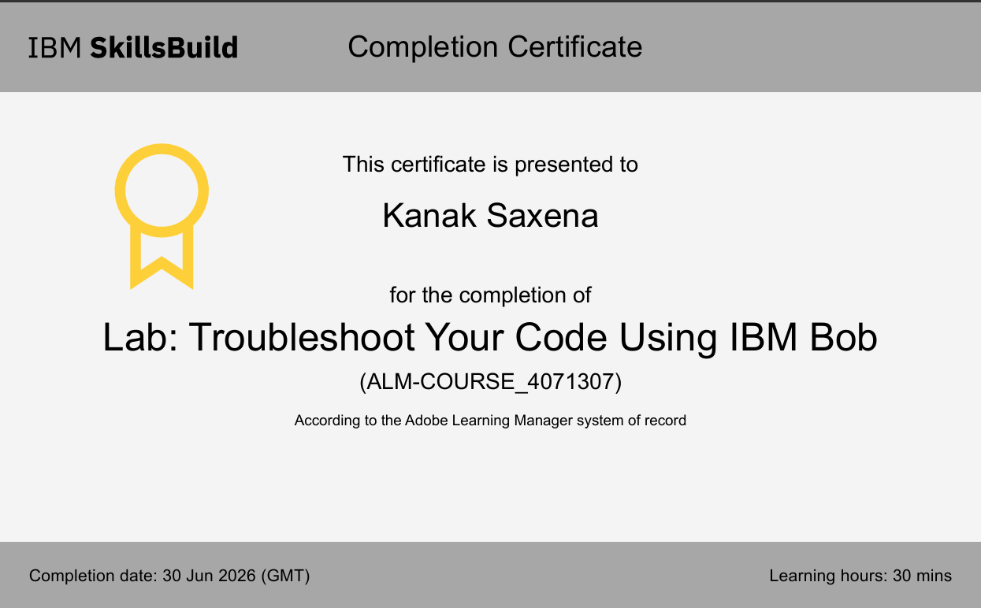
Certificates Earned:​

Slide 14


